Slide 1
Coolidge High School Update
Coolidge HS CWG
January 31, 2018

Slide 2
Tonight’s Goals & Objectives
Coolidge HS Update
We are here to update the CWG about the kind of programming that will be made available at Coolidge High School starting in SY19-20
Get your feedback on planning and implementation considerations

Slide 3
The Academies at Coolidge
Coolidge HS Update
In-boundary and feeder school students will have a right to attend
Academy continues to grow and establishes dual enrollment partnerships
Citywide application program via My School DC lottery
Program will grow grade by grade, starting with 9th in SY19-20
Students may take up to 60 college credits during 11th & 12th grade
In-boundary and feeder school students will have a right to attend
Program becomes Career Academy, modeled on Health Science Academy
Health Science Academy
Mass
Media Academy
Early
College
Academy

Slide 4
The Academies at Coolidge
Coolidge HS Update
Health Science
Courses: Science electives + rigorous core courses
Mass Media
Early College
Courses: Courses in grades 9 and 10 are high school level, with a priority on including Advanced Placement opportunities. 11th and 12th grade students can take college courses with University Partners, earning up to 60 credits by the end of the 12th grade.
Courses: Journalism and production electives+ rigorous core courses
Career Partnership: Industry Board supports guest speakers, site visits, paid internships
Career Partnership: Industry Board supports guest speakers, site visits, paid internships
College Partnership: Faculty/Teacher Partnerships, Dual Enrollment Courses
Certifications: Certified Nursing Assistant; First Aid
University Partnership: Dual Enrollment Courses
Certifications: Adobe Premier Pro & After Effects

Slide 5
Coolidge High School
Coolidge HS Update
No matter the program of study, there are goals and opportunities that should apply to all Coolidge students.
Leadership:
  There will be one Principal to lead Coolidge HS and build a cohesive, inclusive, and aligned school community
  Each program will have a Director to support students and staff
Rigor:
  All students will be able to take rigorous courses like AP at Coolidge
  All students will have access to Dual Enrollment opportunities
Inclusion:
  All students, including students with IEPs and English Learners will receive needed supports regardless of their program
  We will meet students where they are to ensure they are supported in finding the right fit program at Coolidge
Cohesion:
  All students will be able to take arts, music, P.E., and electives and be able to participate in sports and extracurriculars
  Students will take at least some courses across Academy groups

Slide 6
SY19-20: Early College Academy Opens
Coolidge HS Update
 | This School Year 2017 - 2018 | Next School Year 18-19 | SY19-20 | SY20-21 | SY21-22 | SY22-23
Grades served at Brightwood, LaSalle-Backus, Takoma, and Whittier | No Change. Schools serve PK3-8th grades. | No Change. Schools serve PK3-8th graders. | Schools serve PK3-5; 7-8th, 6th Grade moves to Coolidge MS. | Schools serve PK3-5th & 8th grade. 6th-7th grade moves to Coolidge MS | Schools serve PK3-5th graders and become elementary schools | All ES
Grades served at Coolidge MS | School is under construction | School is under construction | 6th grade | 6th-7th grade | 6th-8th grade (Full middle school) | Full MS
Grades served at Coolidge HS (By-Right Comprehensive) | 9th – 12th graders (Coolidge receives 8th graders from ECs) | 9th – 12th graders (Coolidge receives 8th graders from ECs) | 9th – 12th graders (Coolidge receives 8th graders from ECs) | 9th – 12th graders (last year Coolidge receives 8th graders from ECs) | 9th – 12th graders (Coolidge begins receiving 8th graders from Coolidge MS) | 9th – 12th graders
Grades served at Coolidge HS Early College Academy (citywide, selective) | None – program is not yet open | None – program is not yet open | 9th graders | 9th and 10th graders | 9th – 11th graders | 9-12th graders (full program)

Slide 7
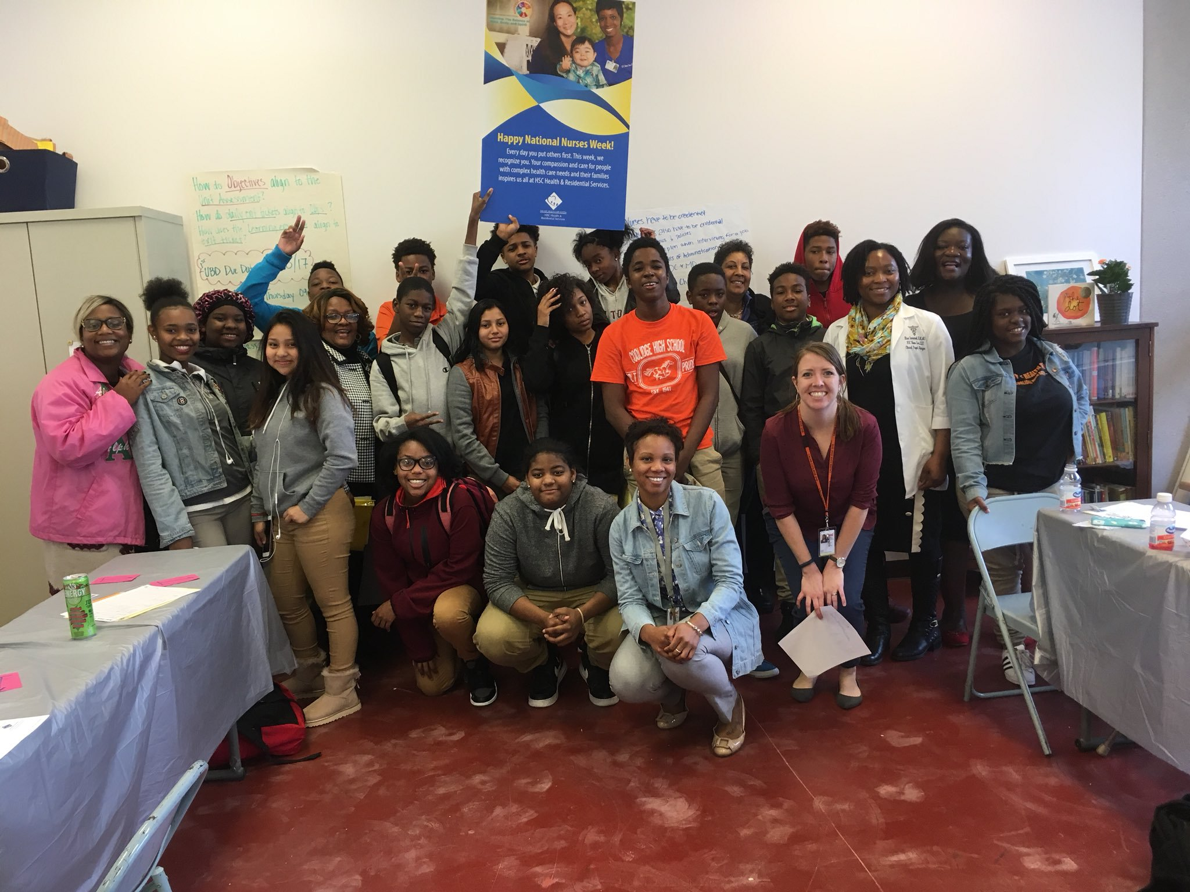
DCPS Career Academies
Coolidge HS Update
What is a DCPS Career Academy?
Career Academy Components
  Curriculum & Instruction
  Work Based Learning & College Exposure
  Industry Advisory Board
  Leadership Structure & Adult Support

Slide 8
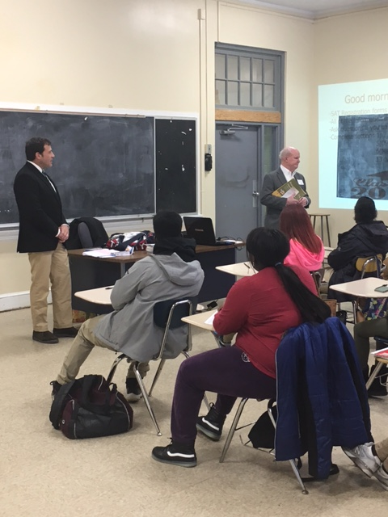
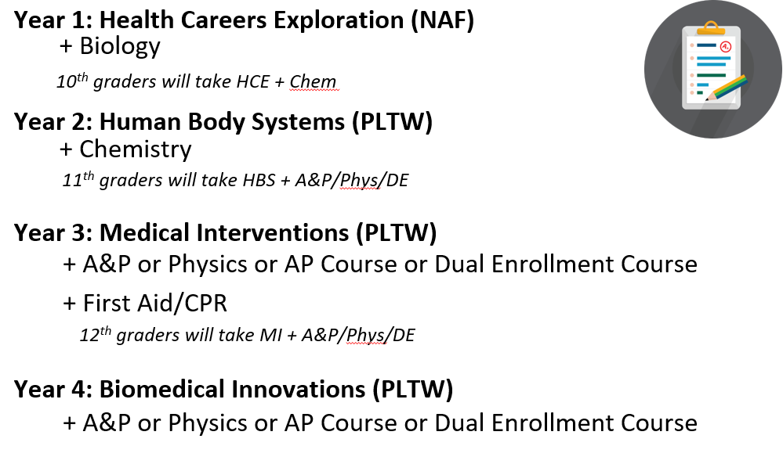
DCPS Career Academies
Coolidge HS Update
Curriculum & Instruction
Notes:
Combination of one NAF Health Sciences course plus 3 project Lead the Way Biomedical Science courses

Slide 9
“Day in the Life” for Academy of Health Sciences: 9th Grade Example
Coolidge HS Update
In each academy, students will take rigorous core classes, electives and classes unique to the course of study in their academy.
Class Period | Subject | Overview
1st Period | Biology | In this course, students would learn about the science of the human body. Also a Core Class required for graduation.
2nd Period | World History I | Core Class required for graduation
3rd Period | Honors English I – Block A | Core Class required for graduation
4th Period | Honors English I – Block B | Core Class required for graduation
5th Period | Health Careers Exploration | This course provides students with a broad overview of health careers, along with required skills and education to pursue these careers.
6th Period | Physical Education | Elective
7th Period | Algebra I – Block A | Core Class required for graduation
8th Period | Algebra I – Block B | Core Class required for graduation
In addition, students will have the opportunity to attend field trips to health and science organizations in the area , see industry speakers and seek internships

Slide 10
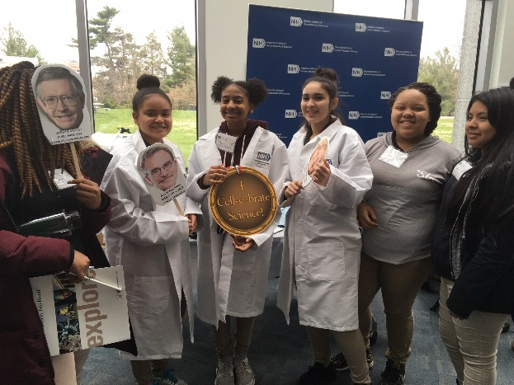
DCPS Career Academies
Coolidge HS Update
To graduate from the Health Sciences Academy, students must complete (with a passing grade):
  Minimum 3 Health Science/Biomedical Science courses
  Minimum 3 cohorted courses with other Academy students
  First Aid/CPR course
  A paid internship

Slide 11
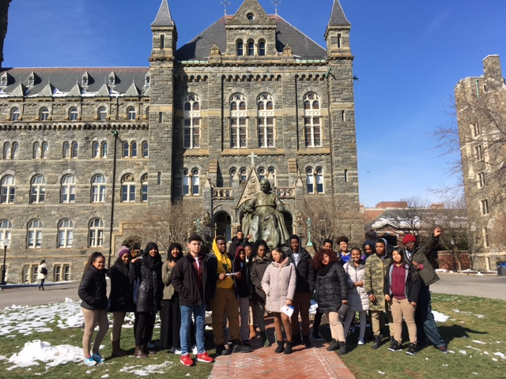
DCPS Career Academies
Coolidge HS Update
Work Based Learning & College Exposure
  6+ Work Based Learning events per year, 3 of which are off-site
  Guest speakers, worksite tours, career fairs, job shadow, mock interviews
  At least one college tour per year for each student

Slide 12
DCPS Career Academies
Coolidge HS Update
Industry Advisory Board
  Meets monthly with industry representatives to support instruction and work based learning. Members come from:
    Association of American Medical Colleges
    Children’s National
    Georgetown School of Medicine
    George Washington University
    HSC Foundation
    Mentors in Medicine
    National Human Genome Research Institute
    Sibley Memorial Hospital

Slide 13
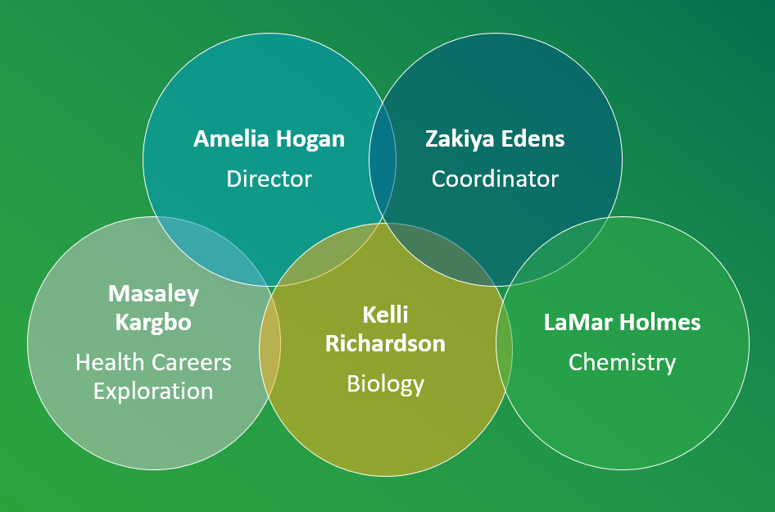
DCPS Career Academies
Coolidge HS Update
Leadership Structure & Adult Support

Slide 14
DCPS Career Academies - Contact
Coolidge HS Update
Amelia Hogan – Director, Academy of Health Sciences
Amelia.Hogan2@dc.gov
(202) 731-5472
Zakiya Edens – Coordinator, Academy of Health Sciences
Zakiya.Edens@dc.gov
(202) 450-0734
Raymond Hutchison – Director, Career Education
Raymond.Hutchison@dc.gov
(202) 480-0874
Andrew Katz-Moses – Manager, College & Career Program Accountability
Andrew.Katz-Moses@dc.gov
(202) 821-6557

Slide 15
Early College Academy: Academic Overview
Coolidge HS Update
In the Early College Academy, students will have an advanced traditional high school experience layered with a college experience in the 11th and 12th grades. Students will apply for the full-time program at one of three university partner schools in the spring of their sophomore year.
9th
10th
11th
12th
Pre-AP and AP courses sequence meeting all DCPS HS graduation requirements for 9th and 10th grade students.
Full Time at Partner University
(2 Years - 60 Credits)
Accepted students will take all classes at the University campus, while remaining a Coolidge student, eligible for sports, clubs, etc.
Application to Early College Options (Spring 10th Grade)
Part-Time at Partner University
(2 Years - 3-30 credits)
Students who are not accepted into the Full Time AA program will take a combination of courses at Coolidge and the partner university, based on academic readiness.

Slide 16
Discussion & Feedback
Coolidge HS Update
What are you most excited about and why?
What questions do you have? What advice do you have that we should consider while planning?
Do you have any concerns or ideas about how to ensure equitable access to the Early College Academy?
How can we get the Coolidge and feeder communities enthusiastic about the Academies and the High School?
  How should we be marketing these academies?

Slide 17
Next Steps
Coolidge HS Update
DCPS will continue engagement with feeder staff and feeder families around the opening of Coolidge MS
DCPS will work with Principal Bright around further outreach to the broader Coolidge school community
DCPS will use feedback from engagement to inform planning for Coolidge HS and the new Coolidge MS.

